Slide 1
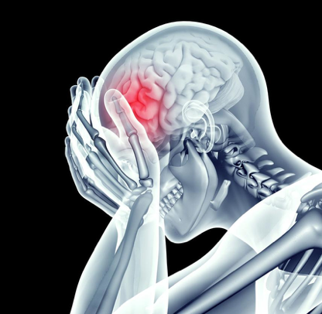
Meta-analysis
Applications to Chronic Pain
Presented on May 18, 2020

Slide 2
Why Meta-analysis?
Individual experiment
Small sample sizes
Flexibility in analysis pipelines
Experimental design variability
Meta-analysis
More power
Convergence across experiments
Can’t control literature
Progress with Meta-analyses
Applications to neuroscience & psychiatry
Automated software available (e.g., Neurosynth, Neuroquery)
Manual meta-analysis
Search term, database, inclusion
Meta-analytic technique
Wager et al., 2007; Müller et al., 2018; Tahmasian et al., 2019

Slide 3
Steps to a Meta-analysis
Decide what to include —> pre-registration
Question, search strategy, inclusion criteria
Database search (and ‘reference chase’)
Screen records
Abstracts
Full-text articles
Extract results & synthesize data

Slide 4
Steps to a Meta-analysis
Decide what to include —> pre-registration
Question, search strategy, inclusion criteria
Database search (and ‘reference chase’)
Screen records
Abstracts
Full-text articles
Extract results & synthesize data

Slide 5
Steps to a Meta-analysis
Decide what to include —> pre-registration
Question, search strategy, inclusion criteria
Database search (and ‘reference chase’)
Screen records
Abstracts
Full-text articles
Extract results & synthesize data

Slide 6
Deciding What to Include
Consider the measure of interest
fMRI response to pain in chronic pain patients compared to healthy controls
Which databases to search?
PubMed, EMBASE, Scopus, PsycINFO, Web of Science, Cochrane
Supplement with ‘reference chase’ from previous meta-analyses
Inclusion criteria
Preregister on PROSPERO

Slide 7
Deciding What to Include
Consider the measure of interest
fMRI response to pain in chronic pain patients compared to healthy controls
Which databases to search?
PubMed, EMBASE, Scopus, PsycINFO, Web of Science, Cochrane
Supplement with ‘reference chase’ from previous meta-analyses
Inclusion criteria
Preregister on PROSPERO

Slide 8
Deciding What to Include
Consider the measure of interest
fMRI response to pain in chronic pain patients compared to healthy controls
Which databases to search?
PubMed, EMBASE, Scopus, PsycINFO, Web of Science, Cochrane
Supplement with ‘reference chase’ from previous meta-analyses
Inclusion criteria
Preregister on PROSPERO

Slide 9
Deciding What to Include
Consider the measure of interest
fMRI response to pain in chronic pain patients compared to healthy controls
Which databases to search?
PubMed, EMBASE, Scopus, PsycINFO, Web of Science, Cochrane
Supplement with ‘reference chase’ from previous meta-analyses
Inclusion criteria
Preregister on PROSPERO

Slide 10
Inclusion Criteria
Whole-brain analyses
Sample sizes 10 or more per group
Statistical threshold
voxel-height p < .001 uncorrected or cluster-corrected p < .05
Criteria specific to measure of interest
fMRI
Chronic pain condition OR pain over 6 months (e.g., PD with pain)
Has to include control group
Confirmed physical pain stimulus
Contrast pain>baseline within-subject
Contrast patient>control between-subjects

Slide 11
Inclusion Criteria
Whole-brain analyses
Sample sizes 10 or more per group
Statistical threshold
voxel-height p < .001 uncorrected or cluster-corrected p < .05
Criteria specific to measure of interest
fMRI
Chronic pain condition OR pain over 6 months (e.g., PD with pain)
Has to include control group
Confirmed physical pain stimulus
Contrast pain>baseline within-subject
Contrast patient>control between-subjects

Slide 12
Inclusion Criteria
Whole-brain analyses
Sample sizes 10 or more per group
Statistical threshold
voxel-height p < .001 uncorrected or cluster-corrected p < .05
Criteria specific to measure of interest
fMRI
Chronic pain condition OR pain over 6 months (e.g., PD with pain)
Has to include control group
Confirmed physical pain stimulus
Contrast pain>baseline within-subject
Contrast patient>control between-subjects

Slide 13
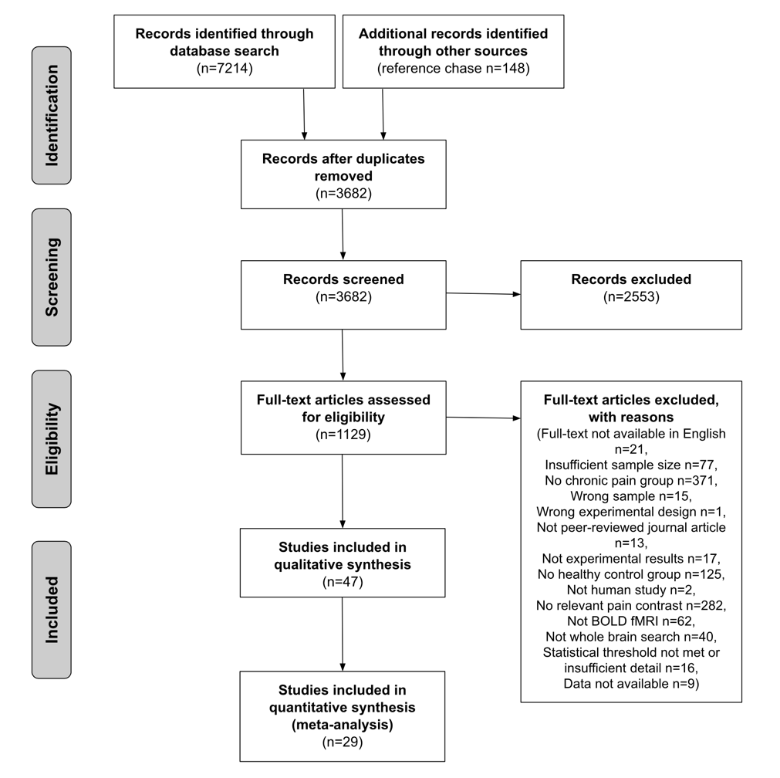
Search
PubMed, Embase, SCOPUS, Web of Science, PsycINFO, Cochrane
’Reference chase’
Generate .ris files
Screen
Use Covidence to read .ris files and record
Abstracts: *exclude* if
NOT fMRI
n<10, <18 age
Animal study
NO patients
Full-text inclusion
Applied criteria
Synthesize
Coordinate data
ALE

Slide 14
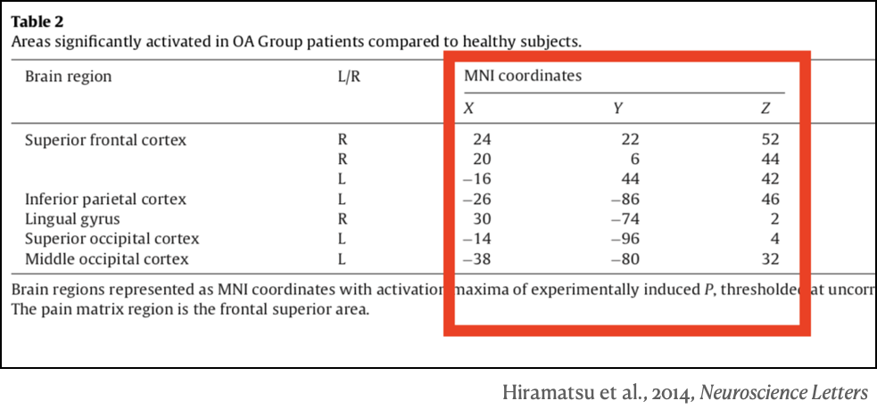
Extract Data
Experimental Information
Pain condition
Medication inclusion criteria
Pain stimulus modality
Pain stimulus location
Pain diagnosis
Coordinates (1 set/exp)
X, Y, Z
Coordinate space (MNI, Tal)
Sample size (patients, controls)

Slide 15
About Our Included Experiments
Mostly migraine patients (n = 7) but also
Fibromyalgia (n = 5), IBS (n = 5)
Chronic back pain (n = 4)
Complex regional pain syndrome I (n = 2)
Chemotherapy-induced peripheral neuropathy, osteoarthritis, persistent dentoalveolar pain disorder, posttraumatic headache, vulvar vestibulitis, mixed patient group (n = 1)
Most used mechanical induction (n = 14) but also
thermal (n = 10)
electrical (n = 4)
chemical (n = 1)
Matched by similar perceptual ratings (n = 18)

Slide 16
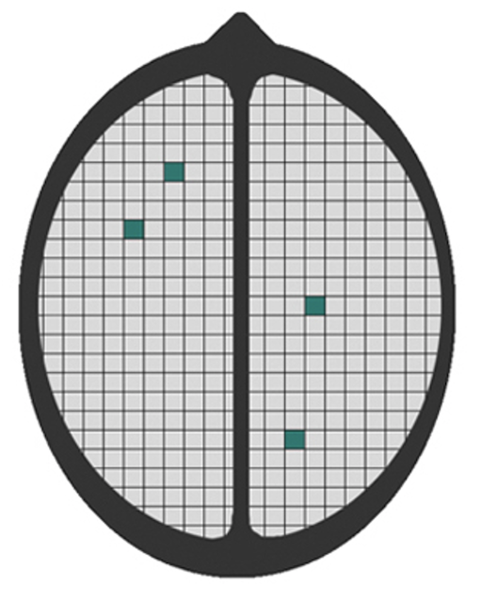
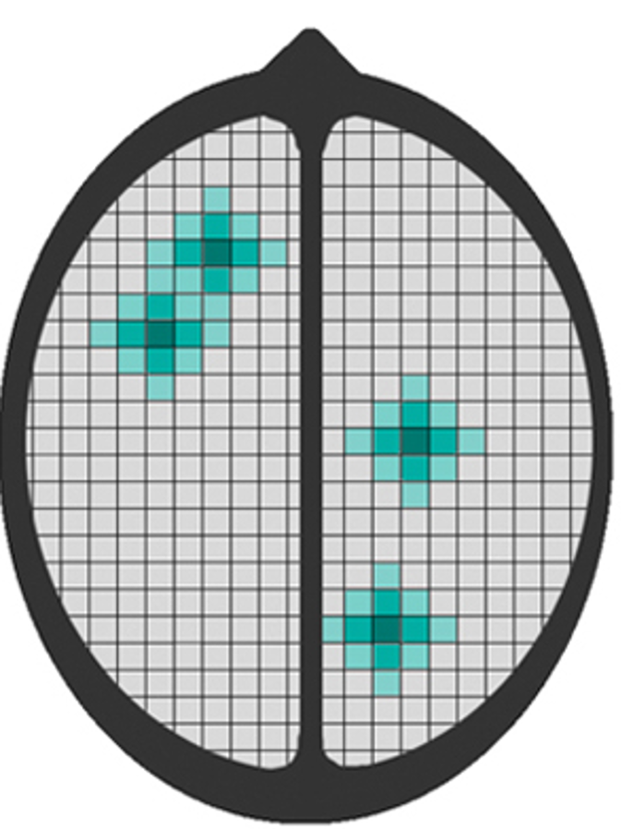
Activation Likelihood Estimation (ALE)
Treat foci as centers of Gaussian distribution
FWHM is determined by n and spatial template
Take voxelwise union to create ALE map
Each voxel represents a z-statistic summarizing probability of activation across experiments
Determine significance
Null hypothesis of spatial independence
Voxel-level: p < .001 uncorrected
Random sampling of grey matter voxels
Cluster-level: p < .05 FWE-corrected
10,000 Monte Carlo simulations to determine cluster
Turkeltaub et al., 2001; Eickhoff et al., 2009; Eickhoff et al., 2012; Acar et al., 2018

Slide 17
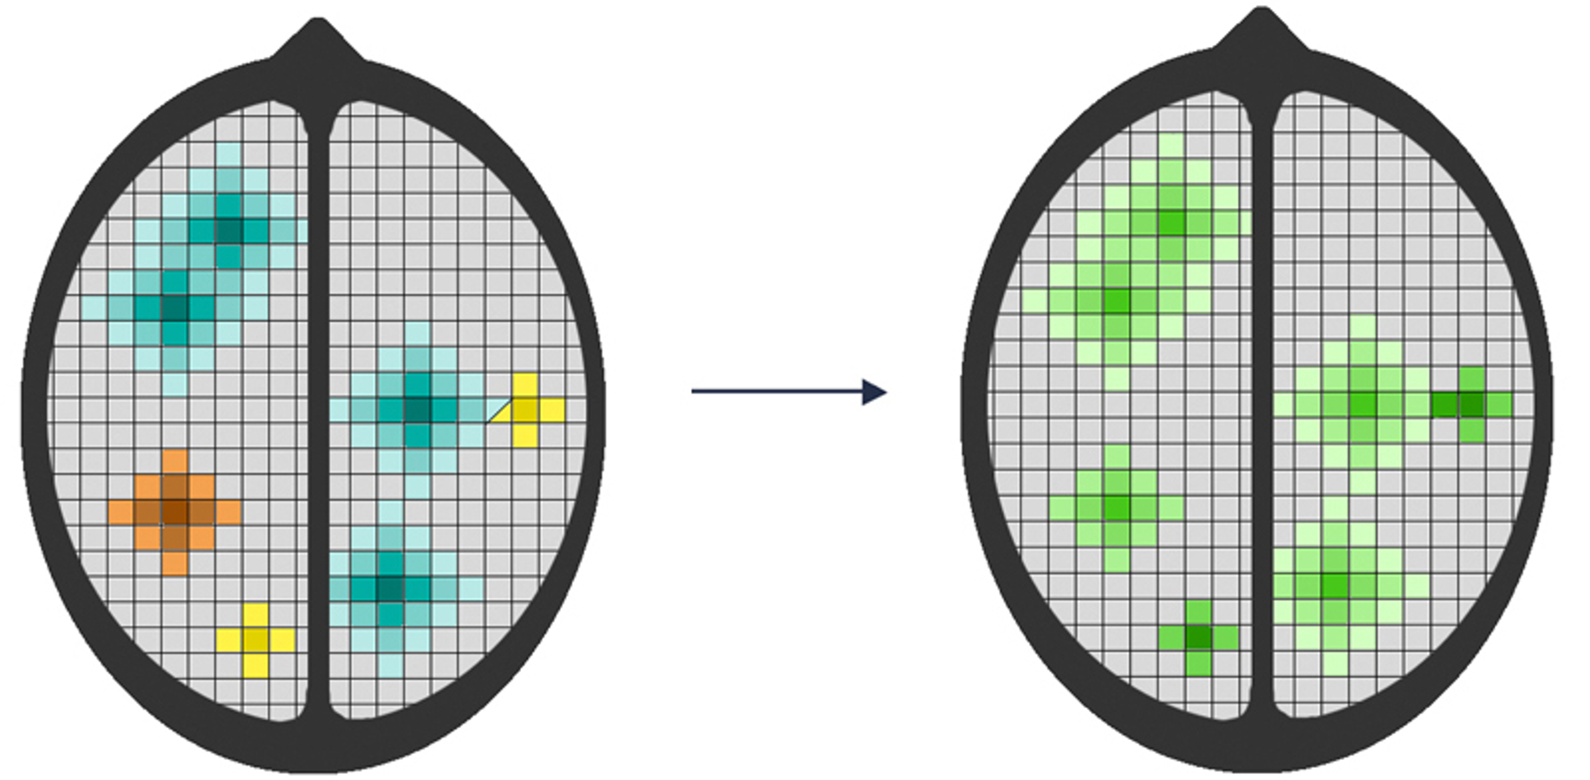
Activation Likelihood Estimation (ALE)
Treat foci as centers of Gaussian distribution
FWHM is determined by n and spatial template
Take voxelwise union to create ALE map
Each voxel represents a z-statistic summarizing probability of activation across experiments
Determine significance
Null hypothesis of spatial independence
Voxel-level: p < .001 uncorrected
Random sampling of grey matter voxels
Cluster-level: p < .05 FWE-corrected
10,000 Monte Carlo simulations to determine cluster
Turkeltaub et al., 2001; Eickhoff et al., 2009; Eickhoff et al., 2012; Acar et al., 2018

Slide 18
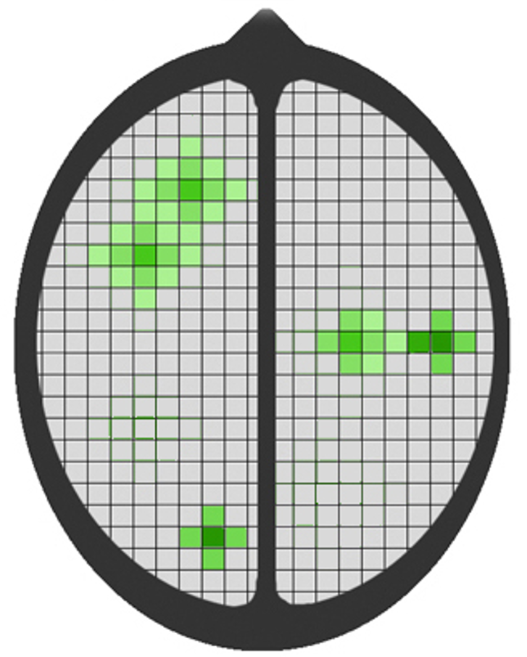
Activation Likelihood Estimation (ALE)
Treat foci as centers of Gaussian distribution
FWHM is determined by n and spatial template
Take voxelwise union to create ALE map
Each voxel represents a z-statistic summarizing probability of activation across experiments
Determine significance
Null hypothesis of spatial independence
Voxel-level: p < .001 uncorrected
Random sampling of grey matter voxels
Cluster-level: p < .05 FWE-corrected
10,000 Monte Carlo simulations to determine cluster
Turkeltaub et al., 2001; Eickhoff et al., 2009; Eickhoff et al., 2012; Acar et al., 2018

Slide 19
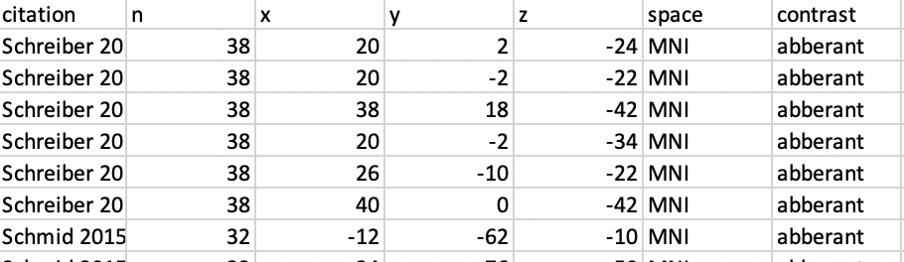
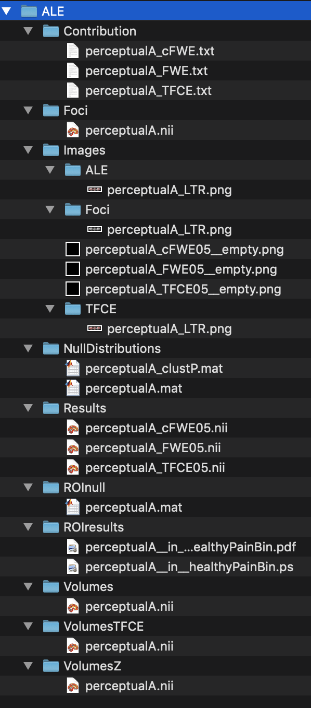
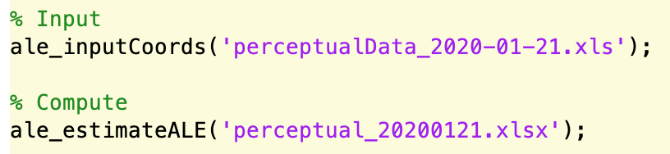
Run ALE Scripts
1. Coordinate Data
2. Define Contrasts
4. Look at Results
3. Run Script

Slide 20
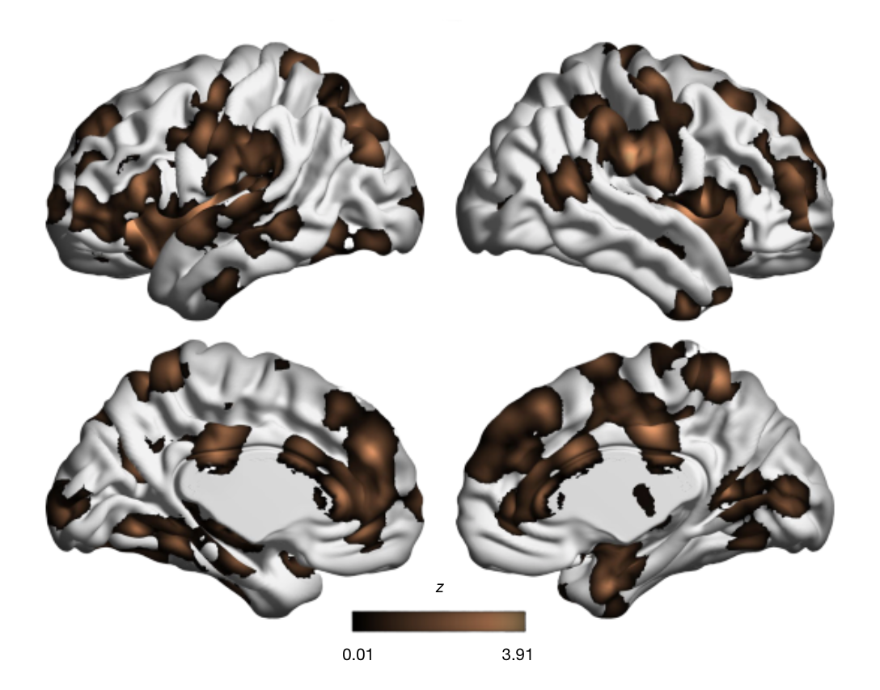
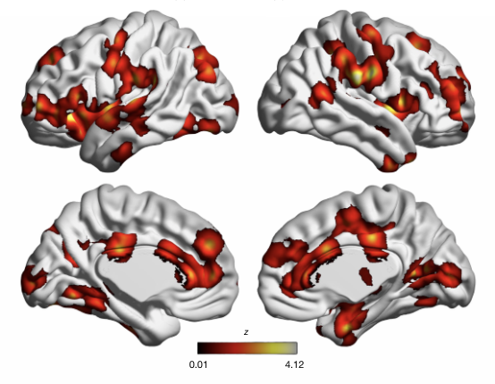
Null Results from ALE Analyses
Inconsistencies in regions associated with aberrant activity
Also true for ”patients > controls” and match by pain ratings (n = 23)

Slide 21
Compared to Healthy Pain Study…
Significant convergence across diverse set of exp’s (n = 222)
Sub-analyses for pain modality, stimulus location

Slide 22
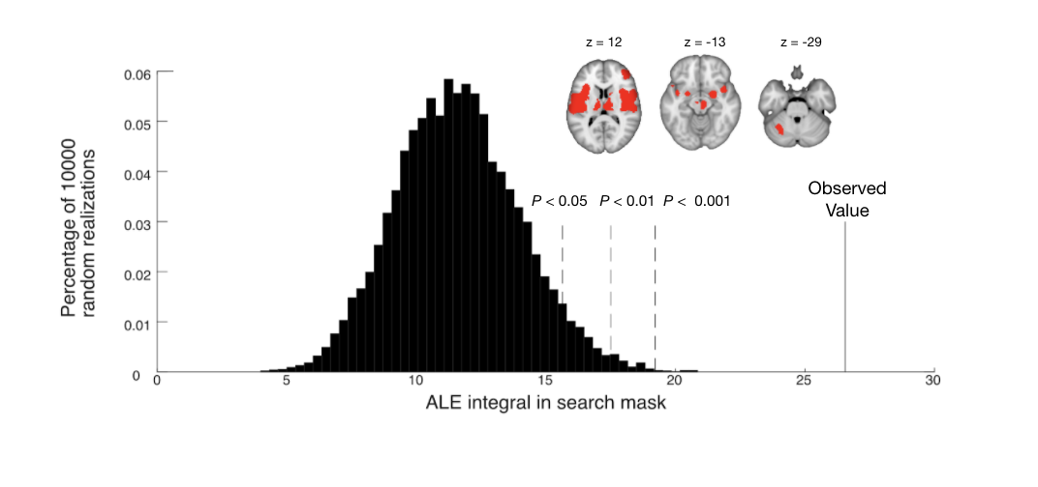
Exploratory, ROI-based Analyses
Overall convergence aggregated across pain areas
Contrast to whole-brain with inconsistencies in voxel patterns of activation

Slide 23
Put It Together: Meta-analysis for Pain
Convergent brain regions in response to pain in healthy
But inconsistencies in regions activated in patients
Overall convergence in pain regions
Not enough experiments for sub-analyses
Future studies focused on pain meta-analytic map
Beyond fMRI : structural MRI differences in chronic pain?

Slide 24
Put It Together: Meta-analysis for Pain
Convergent brain regions in response to pain in healthy
But inconsistencies in regions activated in patients
Overall convergence in pain regions
Not enough experiments for sub-analyses
Future studies focused on pain meta-analytic map
Beyond fMRI : structural MRI differences in chronic pain?
Consistent pain-related regions for (1) biomarker development and (2) field outlook

Slide 25
Future Directions for Meta-analyses
More applications in psychiatry
Further biomarker development with meta-analytic maps
Test with ML?
Use of meta-analyses in different fields
Experimentally-administered psychedelics
Technical developments
Better meta-analytic algorithms
More understanding of properties in different meta-analytic algorithms
Better automated meta-analyses?

Slide 26
Future Directions for Meta-analyses
More applications in psychiatry
Further biomarker development with meta-analytic maps
Test with ML?
Use of meta-analyses in different fields
Experimentally-administered psychedelics
Technical developments
Better meta-analytic algorithms
More understanding of properties in different meta-analytic algorithms
Better automated meta-analyses?

